Slide 1


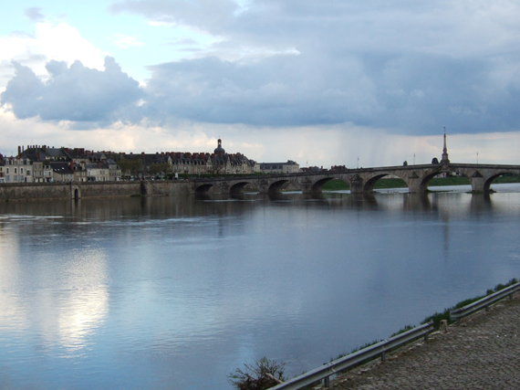
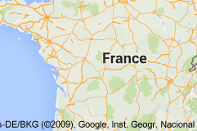
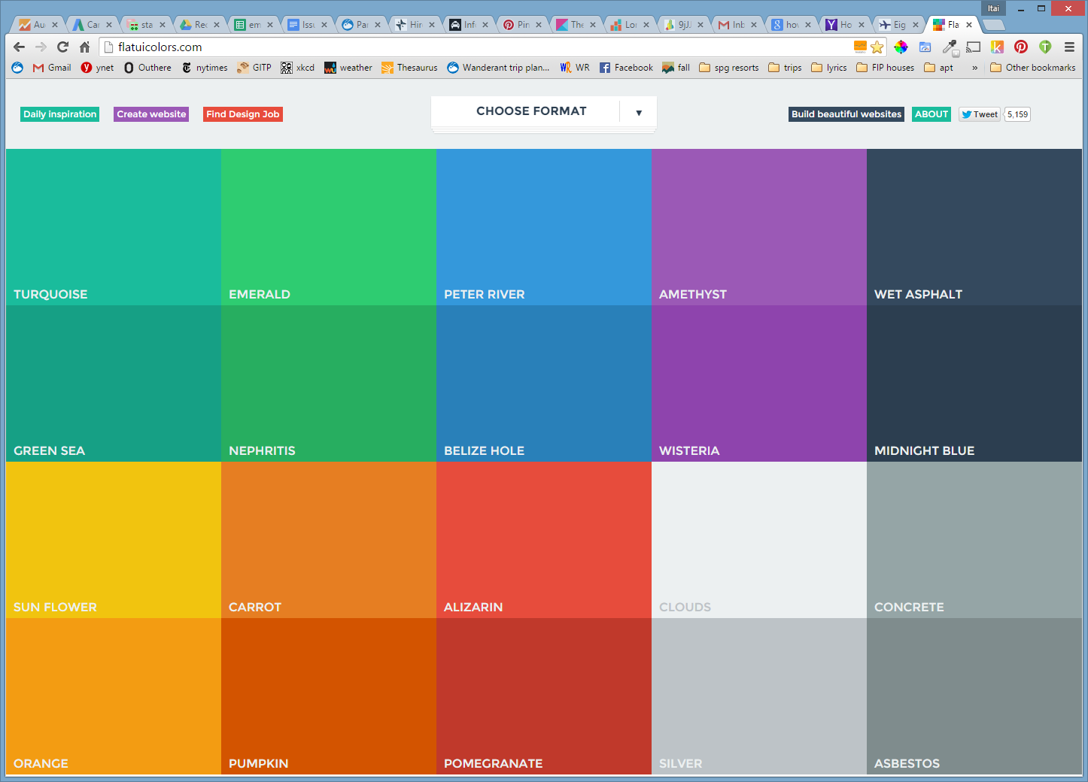
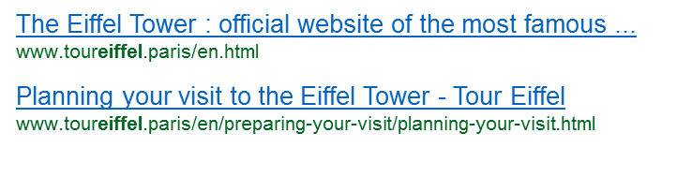


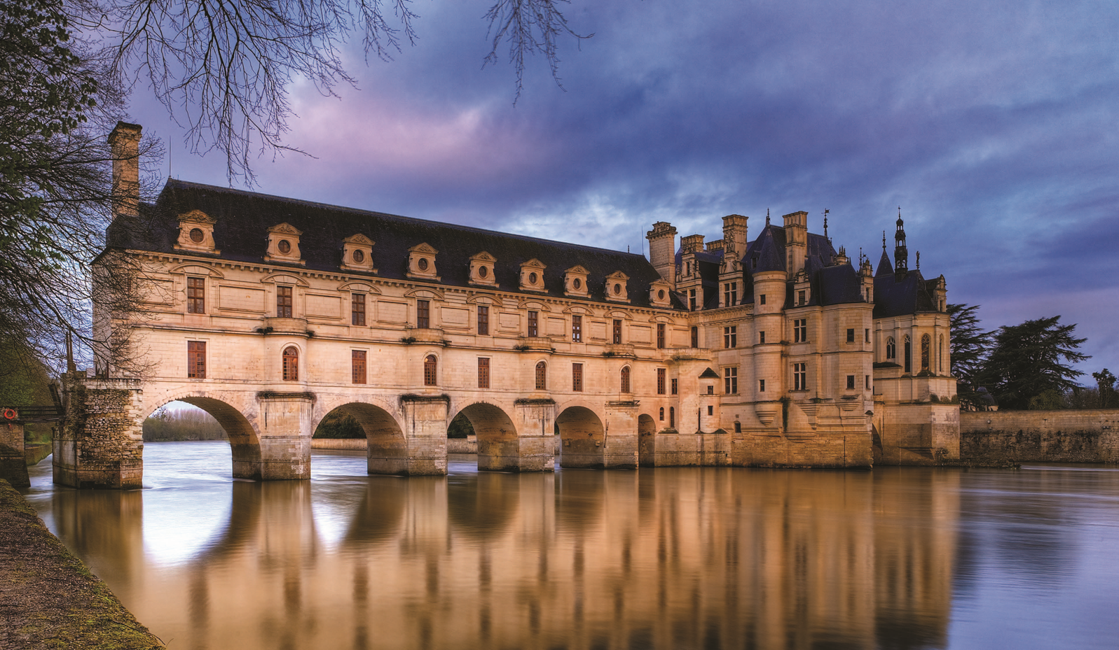
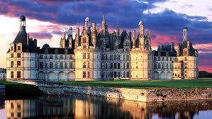
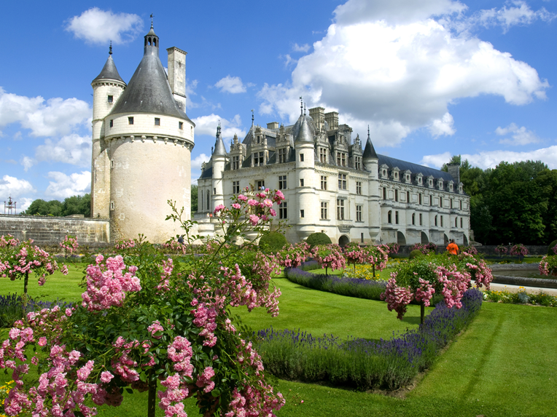
Trip Mind
Search
Recent
France > Loire Valley
Starred
Known for its castles that served blah blah blah blah awladalsk dlaskjd aksdjl askdjlaskdj laskdj laskdja skdja lskdjlask djalskdjalskdj alskdja laksd alskd alskd more…
Places
France
Loire Valley
Blois
United Kingdom
My notes:
Louvretourism.net
Links visited:
Reviews:
Categories
Top pick
Destinations (1)
Find more destinations >
Blois
Town
Attractions (3)
Chateau d’Azay de Rideau
Castle
Chateau de Chenonceau
Castle
Musee de Giverny
Museum
Find more attractions>
Restaurants
Search for restaurants >
Hotels (6)

Slide 3
Map:
Plan route
Save to favorites
Export to google maps
See card on left
Each place:
Stop tracking
Favorite
Edit
Remove (=stop tracking??)
Share
Select multi
Add to collection
Reorder
Sort options:
By geography
By Category
A-Z
Recently seen
Time spent researching
On map
Trash – so you can see what you deleted. Anything in trash will not get tracked until you restore it.
Filter options:
By category
By geo
By favorite or not
Collections:
Some automatic? Same as any other thing really, it’s just you can add it manually into a collection

